Slide 1
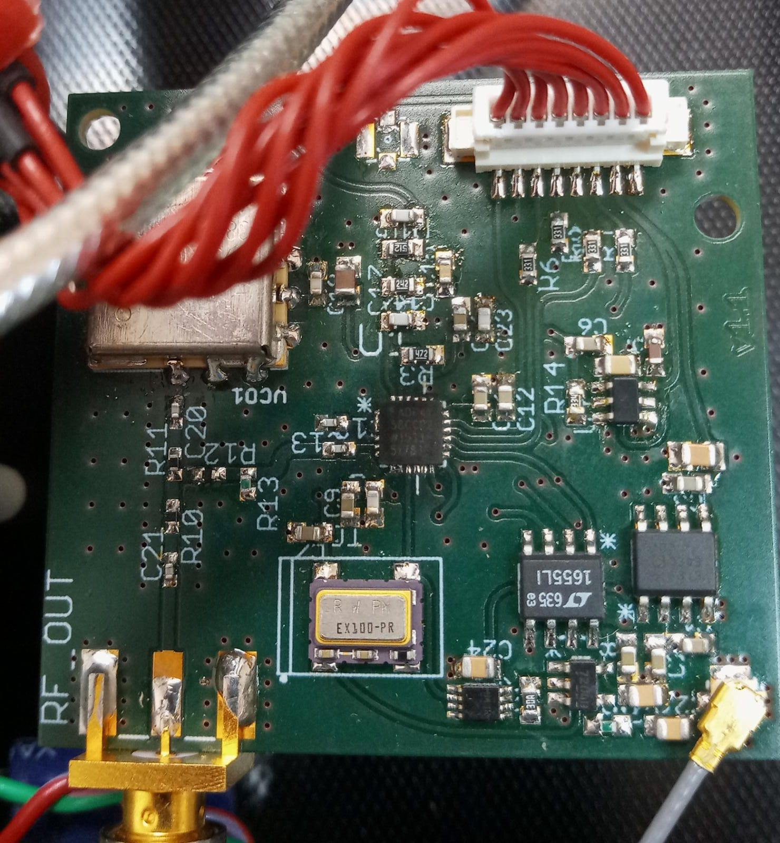
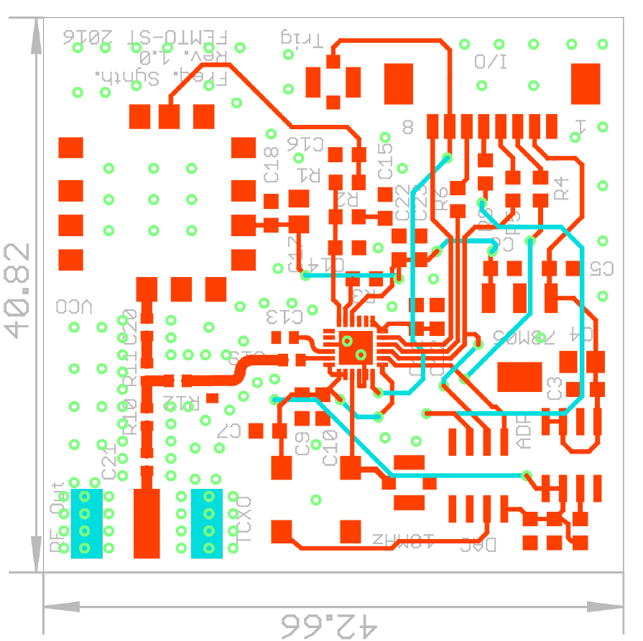
C16: 22nF
C16: 2x330pF
R1: 5.1kΩ
R1: 5.1kΩ
C15: 680nF
C15: 8.2nF
R2: 2.4kΩ
R2: 2.4kΩ
C14: 47nF
C14: 330pF
R3: 4.7kΩ
R3: 4.7kΩ

